Slide 1

VIRTUAL INTELLIGENCE SERVICE
VICTORIA PER INTELLECTUM
SYRIAN INTEGRATED AIR DEFENSE SYSTEM
INTREP VIS-OPAR-002
DRAFT
DISCLAIMER:
This is for multiplayer online gaming using the Digital Combat Systems simulation software published by Eagle Dynamics. The information is not in any way suitable for real world use or operations.
Version: X.X
Published: YYYY-MM-DD

Slide 2
INTRODUCTION
A
A
Aim:
This report intends to present information on the Syrian IADS, how it functions and critical target components.
Reference:
INTREP VIS B-001 Generic Ground Force Structure v1.0
Content:
Part 1: General IADS information
IADS
Command Centre
SAM Site
Early Warning Radar
Connection node
Power supply
AWACS
Air Defense Fighters
IADS Tactics
How to neutralize IADS
Part 2: Syrian IADS
Syrian IADS organization
B
B
C
C
D
D
E
E
F
F

Slide 3
Integrated Air Defence System (IADS)
An Integrated Air Defence System (IADS) is a wide network of surface-to-air forces that work together to defend the skies of a specific area. The system is also connected to the fighter aircraft in the A-A role either in a airborne CAP or intercept aircraft on ground alert that can be scrambled toward incoming threats.
There are several elements that are part of this network, which all will be explained more in detail in the next slides:
Command Centre
Early Warning Radar (EWR)
SAM Site
Sector Command Centre (Connection node)
Power source
AWACS
Air Defense Fighters
Example:
The illustration to the right show a simple IADS. Each sector have a EWR that feeds information into a sector command centre. SAMs are off, and only turn on to fire based on the information from the EWR that they are within range. In addition, as long as the sector is connected to the entire IADS, they can also be activate based on other EWRs in IADS. AWACS is also supporting and contributing via the command center and functions as a extra EWR. Fighters on standby can also be launched to either sector based on radar information from EWR or AWACS.
SECTOR A
SECTOR B
A
A
B
B
SAM 2
SAM 5
C
C
D
D
SAM 1
SAM 3
SAM 4
SAM 6
Sector Command Centre
Sector Command Centre
E
E
F
F
EWR A
EWR B
Command Centre
AWACS
EWR Center
Fighters
Back

Slide 4
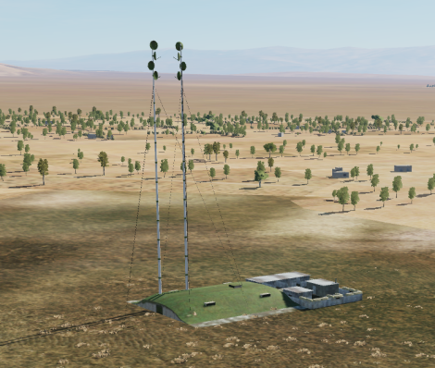
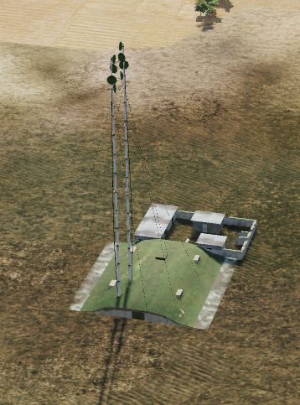
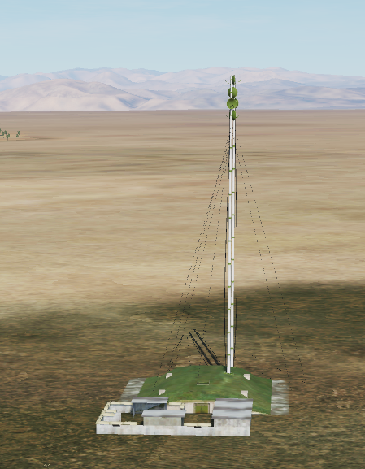
COMMAND CENTRE
This is the central node of the entire IADS.
The command centre coordinates all parts of the IADS and make sure to give orders and information to the relevant parts.
The command centre is powered by a primary powersource and a backup powersource, and by attacking and destroying the powersources the command centre is unable to function.
Often the command centre also will have a backup command centre that takes its function if the primary command center is destroyed. The backup command center will have its own powersources to function
The command center and backup command center are fixed installations that are not moved around.
Example of a command center can be seen to the right.
A
A
B
B
C
C
D
D
E
E
F
F
Back

Slide 5
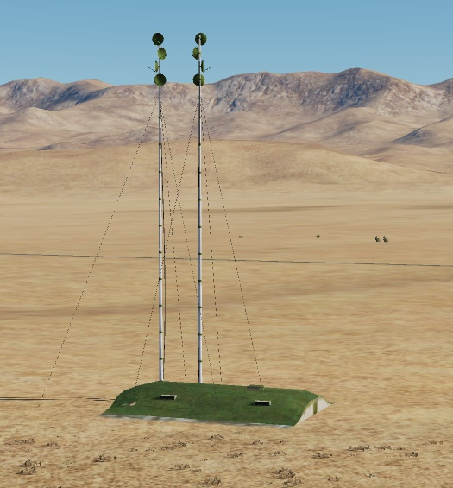
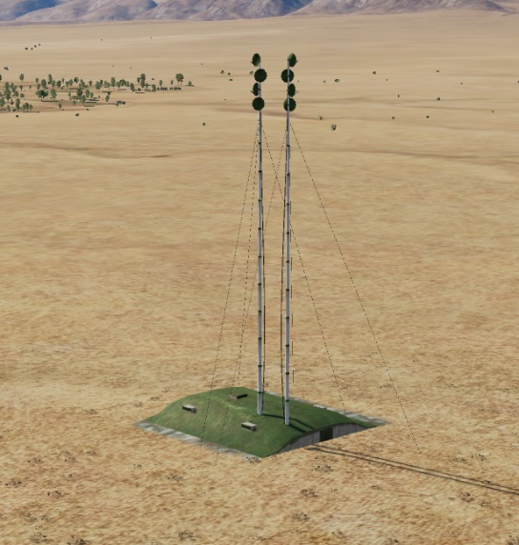
SECTOR COMMAND CENTER (CONNECTION NODE)
The sector command center is the centralized area where a air defense sector is controlled. All SAMs and EWRs in a region will be connected to the sector command center.
The air defense sector will also be supported by the overall IADS resources such as other EWRs, AWACS, air defense fighters flying CAP or interceptors on ground alert.
If the sector command center is destroyed, the sector will be cut off from other IADS resources, some SAMs may then be off permanently (they are not aware that the sector command center is destroyed), or they can be active all the time, making it easier to locate them SAMs in the sector for engagement with standoff precision munitions.
Example of a sector command center seen on the right.
A
A
B
B
C
C
D
D
E
E
F
F
Back

Slide 6
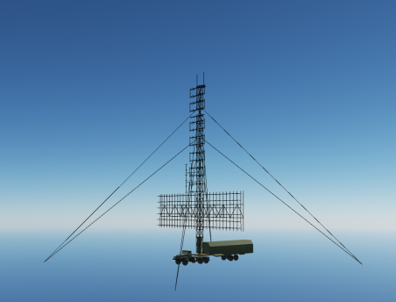
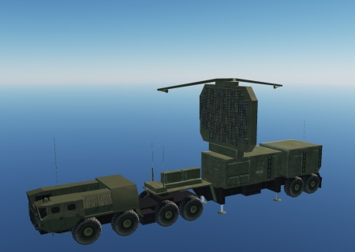
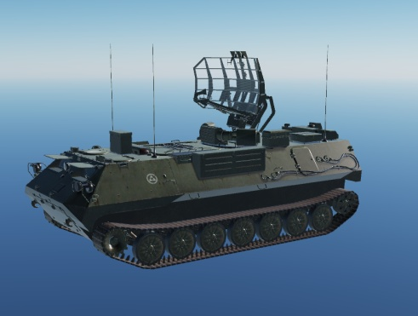
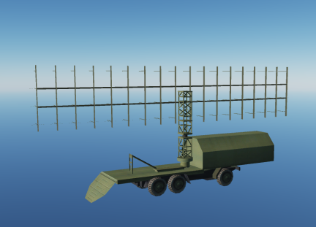
EARLY WARNING RADAR (EWR)
EWRs are critical parts of the IADS network. EWR scan the skies regularly and feed information to the sector command center or the IADS command center. This makes it possible for SAM sites to be dark (radar off), and only activating to fire a missile once they know a target is within range. This create a lethal combination as the first time a pilot may get a warning from the SAM is when it starts firing at the pilot.
EWRs may be on all the time, or be on at regular intervals to ensure good coverage.
EWRs is high value targets that is likely protected by point defense system and are placed within the umbrella of the IADS network.
EWRs are normally placed at locations which gives best possible coverage of the airspace in the sector.
By avoiding detection by EWRs it is possible to sneak in to a sector and conduct the mission without beeing shot at.
Large SAM sites such as the SA-10 have powerful radars that also can be used as EWR.
Examples of EWRs seen to the right.
A
A
B
B
C
C
D
D
E
E
F
F
Back

Slide 7
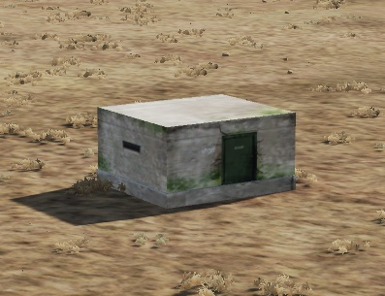
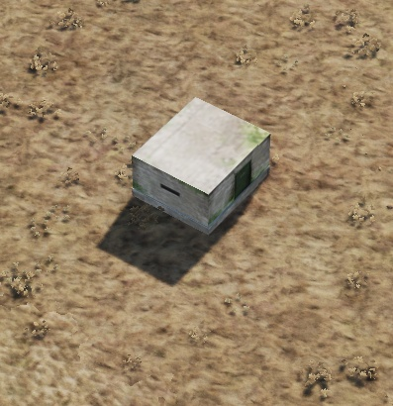
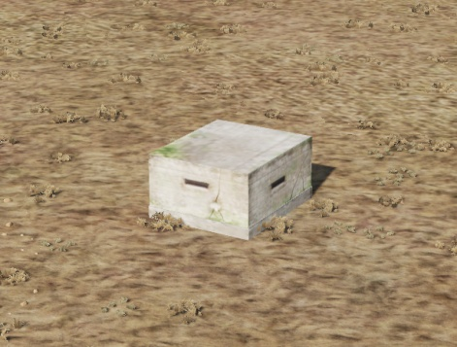
POWER SOURCE
Certain parts of the IADS network may require a external power source to function.
Many elements of the IADS, such as the smaller SAM systems have autonomous power and will not be affected by the destruction of power sources. But EWRs and IADS command center require minmum one power source to operate. Some elements may also have a backup powersource to be able to function in case the primary power source is destroyed.
Examples of primary power source seen to the right.
A
A
B
B
C
C
D
D
E
E
F
F
Back

Slide 8
SAM SITE
SAM Site This element is the actual threat, it can be a big and scary SA10 or a smaller SA8 that falls into the network. They can be a single section, or an entire cluster that is trying to defend an high value target.
Example for this, are SA10 battalion protected by Shilkas, and Tonguskas to help against low level threats, like cruise missiles, low level strikes or helicopters.
SAM are usually static, but for concealment and defence, they can be moved around. Older systems takes days to disassemble, move and assemble, while more modern Russian variants can take just hours.
To avoid detection as long as possible, usually SAMs are kept silent until a target comes into range, and depending on the SAM, it can take some time to launch their missiles.
Better trained SAM crews will shorten this time for the acquisition of enemy aircraft, and usually will wait for it to get closer to a NEZ range [ No Escape Zone ] before launching.
SAM sites can be present in the theatre, but not connected to the IADS, and this would be the case for smaller section that are integrated with ground forces, and work with them to support them directly.
.
A
A
B
B
C
C
D
D
E
E
F
F
Back

Slide 9
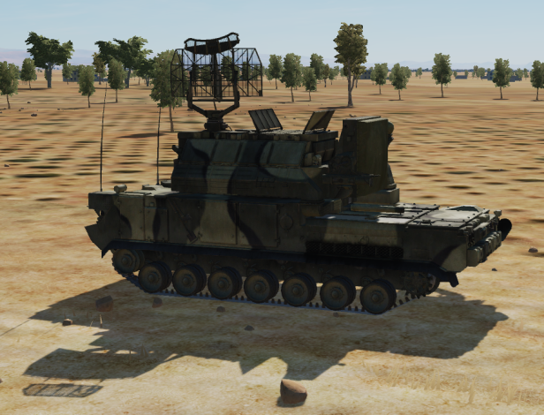
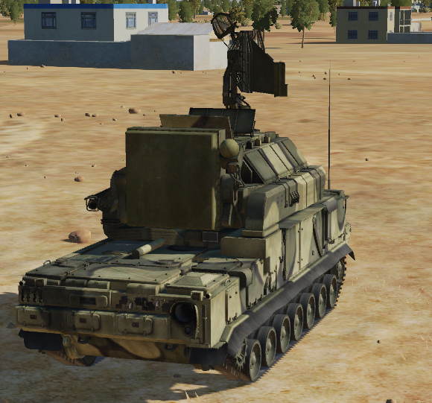
POINT DEFENSE
High Value Targets (HVT) such as EWRs, command centers or important SAMs will have a local point defense. The intention for the point defense is to be able to shoot down Anti Radiation Missiles (ARM) that are beeing launced at the HVT.
The only known point defense system is the SA-15.
It is assessed that if a point defense system is protecting a enemy radar, such as a EWR or SAM, the EWR or SAM may still operate even though a ARM is fired toward it. It will require multiple ARMs to flood the point defense in order to be able to shut enemy radars down if they are protected by point defense systems.
A
A
B
B
C
C
D
D
E
E
F
F
Back

Slide 10
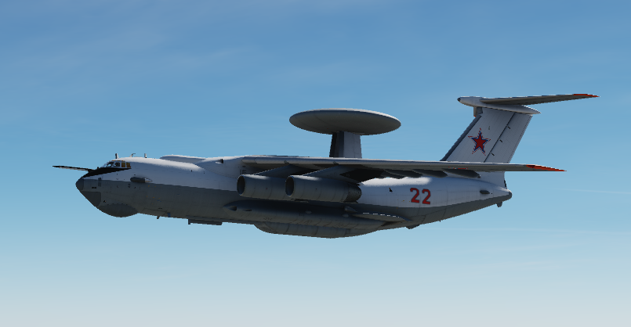
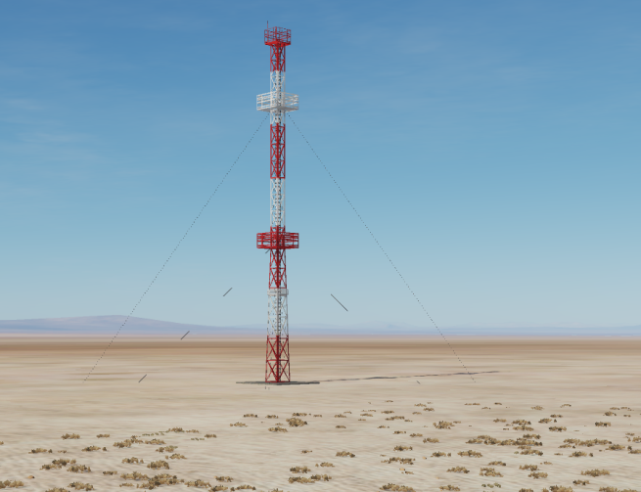
AWACS
AWACS can be a huge contributor to the IADS by providing coverage down into valleys and into areas where the EWRs are not able to detect aircrafts.
AWACS function in the IADS in a similar was as EWRs.
AWACS is limited in numbers and a very high value target if in the air.
AWACS is transmits its information into the IADS and the command center via a connection node, as shown on the picture to the right.
A
A
B
B
C
C
D
D
E
E
F
F
Back

Slide 11
AIR DEFENSE FIGHTERS
AWACS and Ships If they are integrated in the command structure and\or organisation, these entities can feed informations to the IADS through connection nodes..
A
A
B
B
C
C
D
D
E
E
F
F
Back

Slide 12
IADS TACTICS
IADS Tactics
###HARM defence SAM sites and EW radars will shut down their radars if they believe a HARM (High speed anti radiation missile) is heading for them. For this to happen, the SAM site has to detect the HARM missile with its radar.
They will not shut down for each HARM launched in the air, but they will calculate if a missile is going to land close enough to their position, and if so, they will turn silent and stop feeding information to the HARM missile.
###Point defence If an HARM was launched on an emitter, other friendly radars that are close enough can detect the missile incoming and intercept it with their own weapons. For this are required more modern radars, that can pick up the RCS of an HARM missiles. SA10 and SA15 are powerful enough to employ this tactic
###Jamming IADS network can produce jamming to fight enemy sensors. But more intel is needed on this topic
A
A
B
B
C
C
D
D
E
E
F
F
Back

Slide 13
HOW TO NEUTRALIZE IADS
How to neutralise the IADS SEAD and DEAD missions are key to work against this systems, but this is how to direct them.
##Power Sources destruction Depending on the campaign ROE, the destruction of power plants could be allowed. Cutting power to the IADS will force all the SAM site to work autonomously, and being unable to feed each other informations, listen to EW, and coordinate with their command unit. This would result in all the SAMs turning on their sensors, and revealing all the information through the emitters.
##Command Centre destruction Beheading the network will result in general disarray and inability to cooperate, and forcing local commanders to take decisions on their own. Most likely SAMs will operate autonomously, or do nothing during the wait for new orders
##Comuncation Node Destruction If those are discovered and identified, the destruction of this nodes will degrade the ability of the IADS. Could force SAMs some connected via that node to function autonomously and not inside the network.
##EW Radar destruction Blinding the IADS means that they will be forced to rely on other radars with less power, or worse positioning, creating blind spots where to operate freely. SAMs sites could be forced to turn their radar on to try to locate possible threats, giving away their position.
##SAM destruction or suppression SAMs can be engaged with several HARMs or Standoff weapons. If a precise location is discovered, a precise standoff attack can be launched. With less information at hand, HARMs can be used to be launched on enemy radars, forcing them to turn off their emitters and go blind.
A
A
B
B
C
C
D
D
E
E
F
F
Back

Slide 14
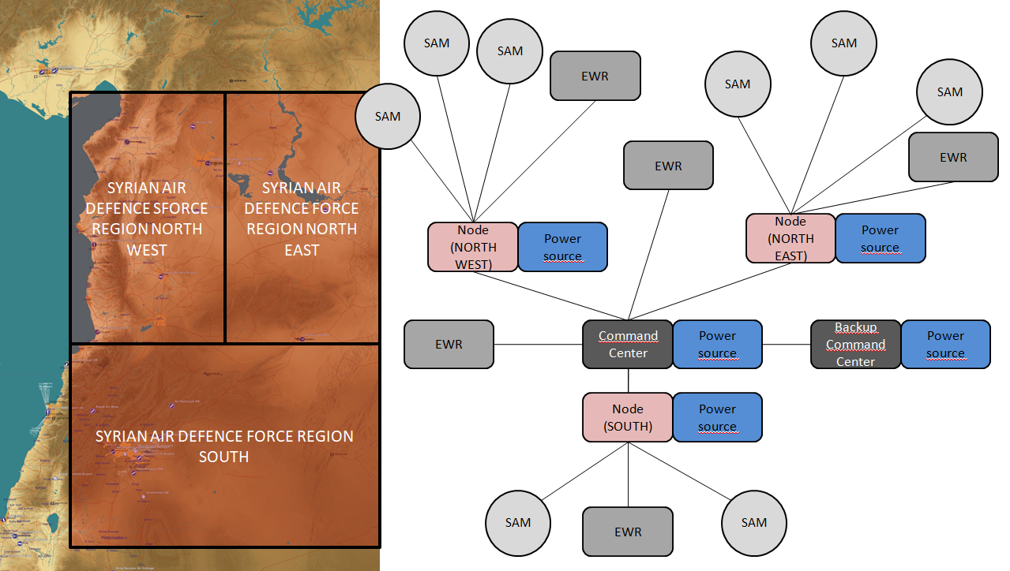
SYRIAN IADS ORGANIZATION
The Syrian IADS is organized in 3 separate regions: Syrian Air Defense Force Region North West (SYR ADFR NW), Syrian Air Defense Force Region North East (SYR ADFR NE) and Syrian Air Defense Region South (SYR ADFR S).
The Syrian IADS consist of a combination of Early Warning radars, SAMs and air defense fighters on ground alert (or airborne in CAPs).
A
A
B
B
C
C
D
D
E
E
F
F
Back

Slide 15
SYR ADF REGION NORTH WEST
The Syrian IADS is organized in the following way:
A
A
B
B
C
C
D
D
E
E
F
F
Back

Slide 16
SYR ADF REGION NORTH EAST
The Syrian IADS is organized in the following way:
A
A
B
B
C
C
D
D
E
E
F
F
Back

Slide 17
SYR ADF REGION SOUTH
The Syrian IADS is organized in the following way:
A
A
B
B
C
C
D
D
E
E
F
F
Back

Slide 18
INTELLIGENCE GAPS
Provide a list of questions or gaps in intelligence, where taskings can be generated to collect information
INSERT MAP HERE
A
A
B
B
C
C
D
D
E
E
F
F
Back

